Slide 1



KONGU ENGINEERING COLLEGE LABEL CUTTING AND COUNTING MACHINE
DEPARTMENT OF MECHATRONICS ENGINEERING
PRESENTED BY
SAHANA M - 23MTR080
SHARMILA D - 23MTR092
THIRSHNA MP - 23MTR107
1

Slide 2
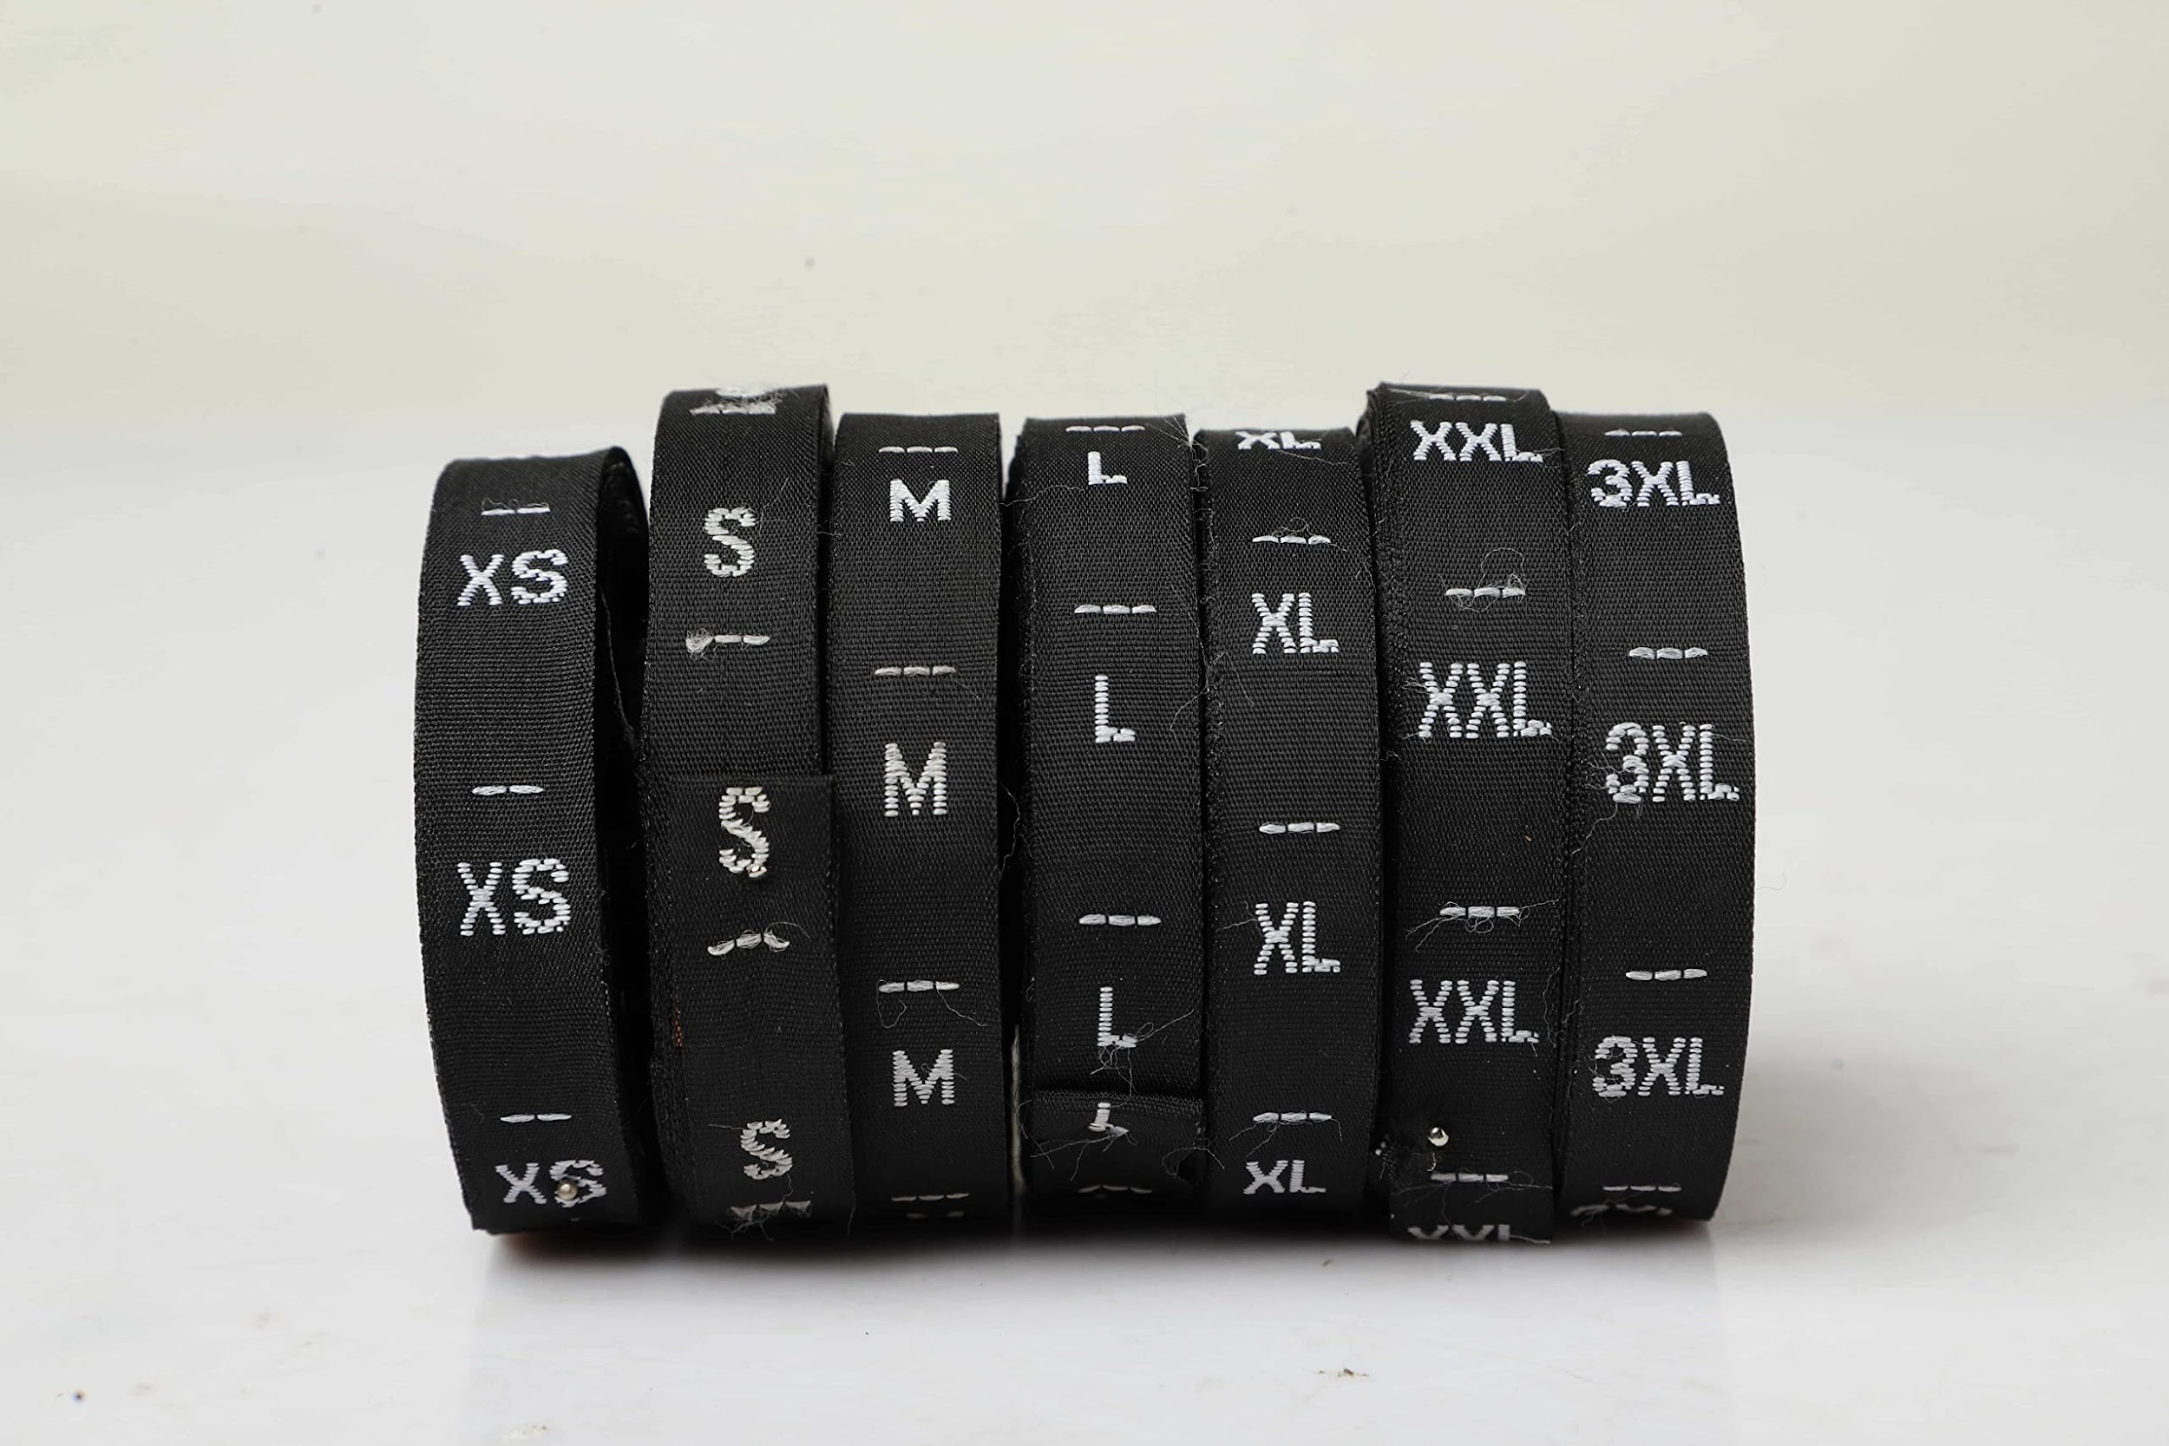
INTRODUCTION
Label’s count are made based on their weight or counted manually ,there is no automation to count labels.As the labels are sold based on their count the buyers count it manually to check whether the count satisfies their need or not. If not they need to place another order so it consumes time and counting it manually also takes time. There is a possibiblity even for the seller to suffer a loss.

Slide 3
LITERATURE REVIEW
S.NO | TITLE | AUTHOR NAME | JOURNAL NAME & YEAR O | REMARKS
1 | Novel labelling algorithm for object counting | M swaraj raman ,M sukanya | IEEE-2020 | New labeling algorithm which has the ability to distinguish certain overlapping objects
2 | Precision Label Cutting and Counting System for High-Speed Production Lines | Chen et al. | Sensors-2020 | The integration of computer vision techniques, such as image processing and pattern recognition, to enable precise label cutting and accurate counting.
3 | Quality Control and Inspection Techniques for Label Cutting and Counting Machines | OSAMA SAADI, ERGUN ERCELEBI | International Journal of Electrical, Electronics and Data Communication-2020 | The importance of ensuring label accuracy, alignment, and defect detection during the cutting and counting process.

Slide 4
LITERATURE REVIEW
S.NO | TITLE | AUTHOR NAME | JOURNAL NAME & YEAR O | REMARKS
4 | Integration of RFID Technology in Label Cutting and Counting Machines | S.Vimaladevi, K.D. Vishnupriyan, F. Vimalraj, G. Vadivel | International Research Journal of Engineering and Technology (IRJET)-2019 | RFID-enabled machines improve efficiency, reduce errors, and enable real-time inventory management in industrial settings.
5 | Optimization of Label Cutting and Counting Machines Using Artificial Intelligence Techniques | Amnon Shashua, Member, IEEE, and Tammy Riklin-Raviv | IEEE TRANSACTIONS ON PATTERN ANALYSIS AND MACHINE INTELLIGENCE-2019 | the potential of AI-driven systems in improving machine uptime, reducing downtime, and enhancing overall productivity.

Slide 5
SUMMARY FROM LITERATURE
These selected literature pieces provide insights into the design, functionality, quality control, integration of technologies, and optimization of label cutting and counting machines. They demonstrate the importance of automation, precision, and efficiency in label processing, highlighting the advancements made in this field.

Slide 6
PROBLEM STATEMENT
Usually the companies buys labels from the labels manufacturing unit based on weight as it doesn’t provided with label counting machine and the buyer often suffers with loss of labels. The production unit sells labels after cutting the labels. The textile companies can’t afford the cutting machine and they need to invest for each and every labels for the cutting.so, we come up with an idea of making label cutter and counting machine economically.
6

Slide 7
OBJECTIVE
“To check for good labels , cut and display the count and discard the defective one”
There is an automation to cut labels , while cutting labels it is easy for us to make a count of it .There may be some labels which doesn’t have a print which might be an empty cloth so to check this, we are performing image processing and counting only good labels and discarding the defective one.so,the cutting and counting machine will prepared economically.
7

Slide 8
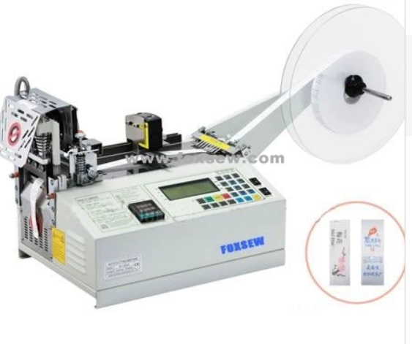
TECHNOLOGY AND TOOLS
Tools
Label cutting machine
Technology
Image processing

Slide 9
ROLLING
Rolling refers to the process of feeding a continuous roll of fabric or material through the machine for efficient cutting and labeling.
In the mechanism, a roll of cloth labels is typically mounted on a stand and the machine is designed to unwind the fabric continuously. As the cloth label roll unwinds, it passes through cutting and counting operations.
The rolling mechanism ensures a smooth and continuous feed of material, allowing for a high-speed and automated production process. It minimizes interruptions, enhances efficiency, and enables precise cutting and labeling of cloth labels in a consistent manner.

Slide 10
CUTTING
In cloth label cutting and counting machines, cutting refers to the process of separating individual cloth labels from a larger roll or sheet of labels.
This is typically done automatically by the machine, which is programmed to cut the labels at specified intervals or based on predefined patterns.
The cutting mechanism may involve blades or other cutting tools, depending on the design of the machine.

Slide 11
COUNTING
After cutting, the counting aspect comes into play. The machine is equipped with a counting mechanism that keeps track of the number of labels produced.
This ensures accurate production and helps in managing inventory.
The counting process can be based on the number of cuts made or may involve additional sensors to verify each separated label.

Slide 12
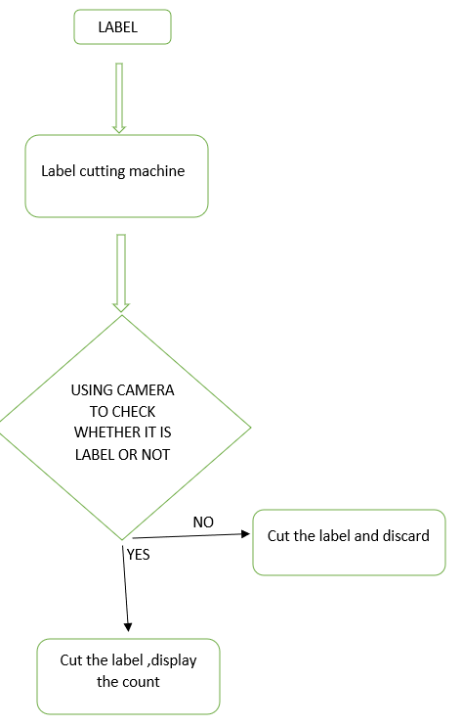
METHODOLOGY
12

Slide 13
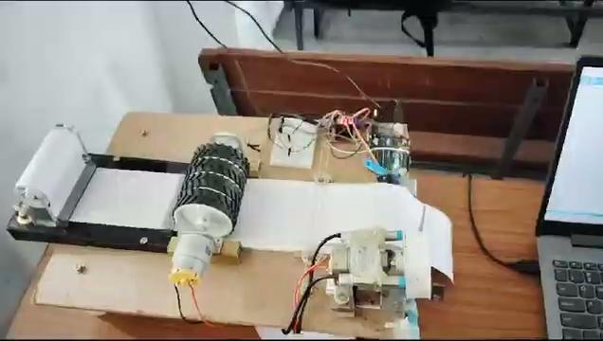
WORK DONE SO FAR

Slide 14
REFERENCES
[1]
https://ieeexplore.ieee.org/abstract/document/6395904

Slide 15
THANK YOU

